Slide 1

Angelica Harvey

Slide 2
Strategies
Strategy One: Increase revenue by reducing car cost to the top 10 % performing vehicles.
Strategy Two: Monthly promotions of a 3- day weekend rental for $25.00/ day on top 10 % performing models at all locations.
Strategy Three: Combining the increased revenue by decreasing car cost yearly along with monthly promotions with top 10 % performing vehicles at all locations.

Slide 3
Base Total Compensation
Base Compensation | Total Revenue | Total Base Car Cost | Total Base Car Insurance | Total Base Profit
 | $64,866,040.00 | $2,353,692.14 | $402,698.58 | $62,109,649.28

Slide 4
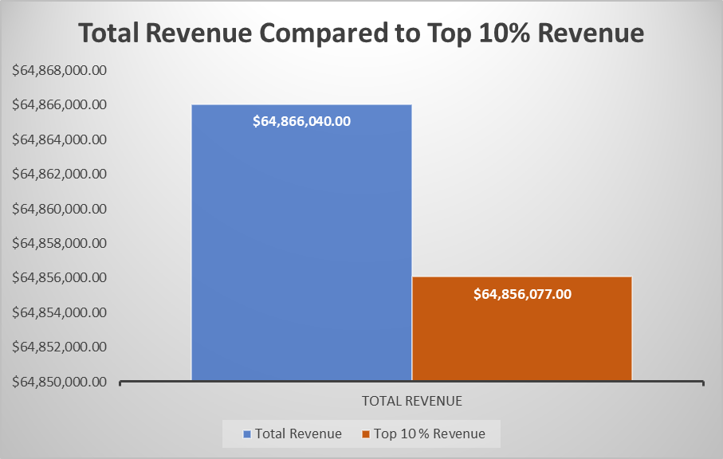
Top 10 % Compensation | Top 10 % Revenue | Top 10% Car Cost | Top 10% Insurance | Total Profit
 | $64,856,077.00 | $2,340,519.98 | $400,332.50 | $62,115,224.52
Strategy 1: Top 10% of Vehicles Rented
I have taken the top 10% of vehicles rented to compare the revenue and profit made by these vehicles. With doing this the car cost is reduced by $13,173.16 and insurance is reduced by $2,366.08. The chart shows a comparison of revenue however profit increased by $5,575.24.

Slide 5
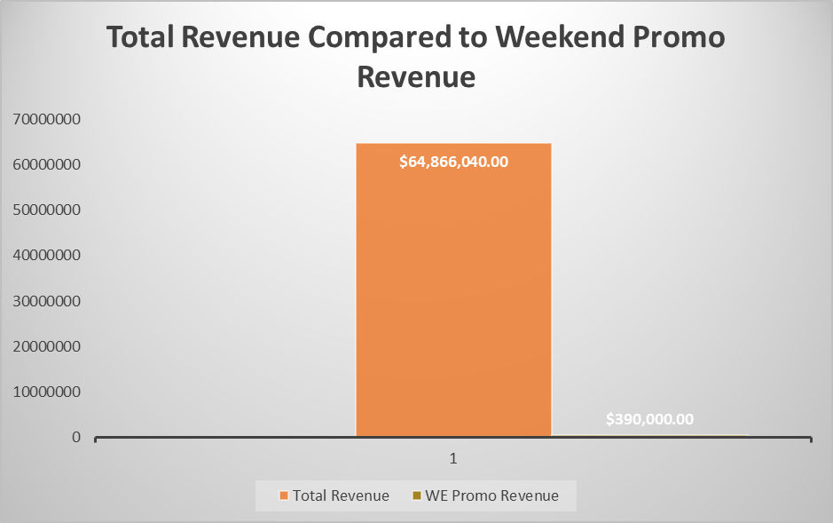
Strategy 2: Week-End Promotion Compensation This is a monthly weekend promotion that can be ran for all locations. The revenue model is of the top 10% of vehicles rented. There is no increase in revenue nor profit. However I am able to combine strategy one and strategy two to come up with our third strategy to generate more profit.
WE Promo Compensation | WE Promo Revenue | Car Cost | Car Insurance | Total WE Profit
 | $195,000.00 | $2,340,519.98 | $400,332.50 | -$2,545,852.48

Slide 6
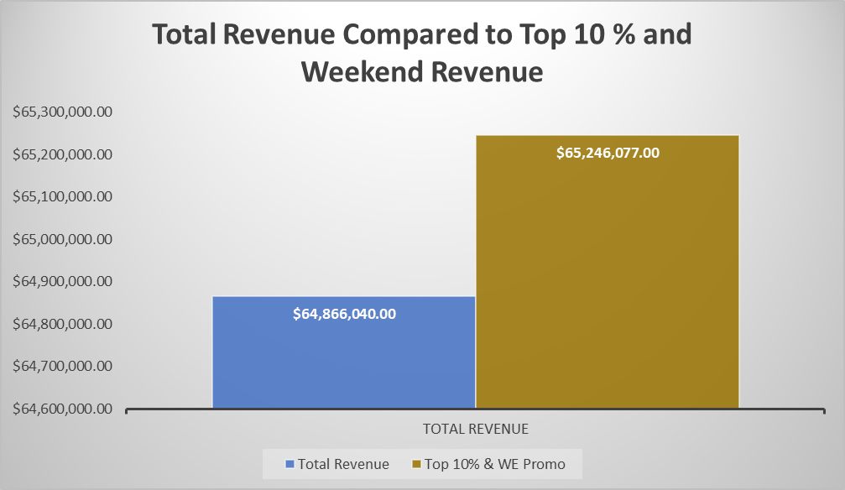
Strategy 3: Combined Strategies Compensation Combining strategy one and strategy will increase revenue by $185,037.00 however profit has decreased. I have taken a comparison of revenue generated.
Combo Compensation | Top 10% & WE Promo | Car Cost | Car Insurance | Total Profit
 | $65,051,077.00 | $2,340,519.98 | $400,332.50 | $59,569,372.04

Slide 7
Based on the current inventory of approximately 4000 vehicles for all locations. Majority of these vehicles have been rented twice by each facility. Strategies provided could increase revenue by combining the top 10% performing vehicles and a monthly weekend promotion to bring in more revenue for the next fiscal year.

